Slide 1
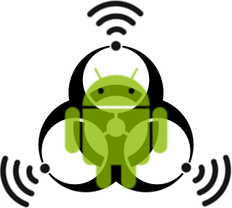
CONTAGION
Tetherball, LLC • 10333 North Meridian Street #245 • Indianapolis, IN • 46290 • 317-818-8800 • www.tetherball360.com All RIghts Reserved © 2012

Slide 2
What is Contagion?
Contagion mobile leverages NFC enabled devices and tags to create a new interactive way to market products in the mobile arena.
NFC SMART POSTERS
Multiple NFC chips on one poster
Chip prompts NFC enabled phone to sign up for membership program
Another chip visually displays coupon w/ barcode via app
PHONE-TO-PHONE COUPON SHARING
Links two NFC enabled phones
Shares coupons between two phones
Opts-in receiving phone to SMS program
Tetherball, LLC • 10333 North Meridian Street #245 • Indianapolis, IN • 46290 • 317-818-8800 • www.tetherball360.com All RIghts Reserved © 2012

Slide 3
Market for NFC
NFC Devices
The market for NFC phones is rapidly expanding
Expected shipment in 2012: 21 million in U.S. and 186 million worldwide
35% of phones shipped in US expected to have NFC by 2015
38% of phones shipped worldwide by 2016
NFC Smart Poster
NFC Posters have been widely unused to this point
NFC tags currently used for things like event planning (tap at each station at an event)
Tags and chips mostly used for loyalty programs and to fill specific needs
Technology is there; just needs to be taken advantage of
Tetherball, LLC • 10333 North Meridian Street #245 • Indianapolis, IN • 46290 • 317-818-8800 • www.tetherball360.com All RIghts Reserved © 2012

Slide 4
Requirements for Solution
NFC Smart Poster
One chip programmed to send and store a visually displayed coupon upon being tapped
Opt-in chip which executes the following:
Ask user if they are willing to opt-in
Send phone number to server is “Send” is pressed
Server checks validity of number
If valid, user is opted-in and receives coupon
Poster to house chips
NFC chip reader/writer/encryption device to program chips
Phone-to-Phone Coupon Sharing
NFC enabled phones/devices
Android/Java
Development of Contagion App
Method of development and testing
Tetherball, LLC • 10333 North Meridian Street #245 • Indianapolis, IN • 46290 • 317-818-8800 • www.tetherball360.com All RIghts Reserved © 2012

Slide 5
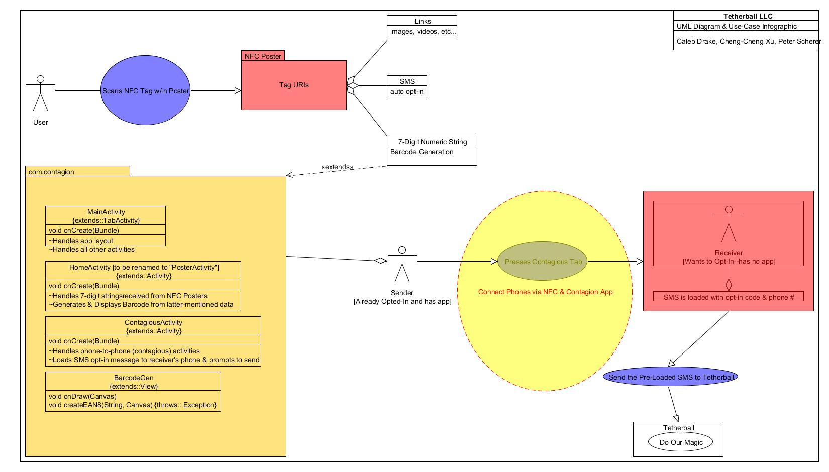
Use Cases and Infographics
Tetherball, LLC • 10333 North Meridian Street #245 • Indianapolis, IN • 46290 • 317-818-8800 • www.tetherball360.com All RIghts Reserved © 2012

Slide 6
Why Contagion?
NFC Market
Extremely fast growing
Replacing QR Codes
Opens an entire new avenue of mobile marketing for our clients
Interactivity
The big, interactive displays will draw more customers in, increasing membership and coupon related revenue for clients
Current smartphone users used to games and web surfing on their phone will be excited about new ways to interact
Viral Marketing
With coupon sharing, membership programs will market themselves
Offer a new way to sign up for programs – increase acquisition rate
Competition
Press Release factor helps draw in clients
App and smart posters help differentiate us
Help us get a leg up on emerging NFC and dying QR code markets
Tetherball, LLC • 10333 North Meridian Street #245 • Indianapolis, IN • 46290 • 317-818-8800 • www.tetherball360.com All RIghts Reserved © 2012

Slide 7
QUESTIONS?
Tetherball, LLC • 10333 North Meridian Street #245 • Indianapolis, IN • 46290 • 317-818-8800 • www.tetherball360.com All RIghts Reserved © 2012

